Slide 1

Own the moments:
Notes:
Paid/owned/earned.

Slide 2




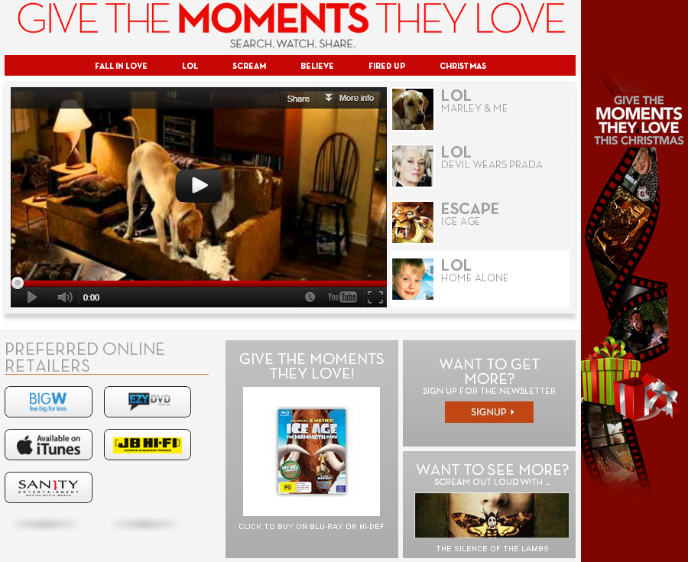
Background/Brief
Fox ‘own the moments’
The Concept:
Fox recognized that users were searching for their movies and being directed to illegally uploaded fan clips.
OTM is a Fox-owned destination that houses hundreds of clips from various Fox movies (Die Hard, Sound of Music, Something About Mary, etc) and provides high-quality videos of theses clips with a path to purchase.

Slide 3





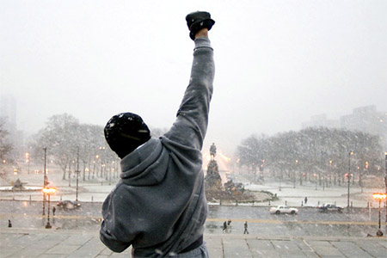
CHALLENGE
Fox ‘own the moments’
VIRAL TOP 10
Fox CLIENT HAD POOR UNDERSTANDING OF DIGITAL
defining kpi
measurement
1ST IN ENTERTAINMENT INDUSTRY TO LAUNCH THIS. No “off the shelf” service.
Number of videos
EDUCATIONAL PRESENTATIONS & training ON DIGITAL PERFORMANCE.
Developing a prioritisation of kpis for video performance
Providing a range of benchmarks for campaign
creative campaign structured to focus on core titles & accommodate video volume

Slide 4








Strategy
TESTING
AN INITIAL 1 WEEK TRIAL SET UP TO TEST A TRADITIONAL TRAFFIC DRIVING MODEL (Google) vs. an engagement model using youtube’s true view offering.
ADOPTING
FOLLOWING THE TEST WE adopted the best performing engine strategy, agreed appropriate KPIs & provided industry average/ local market benchmarks.To gage performance.
OPTIMISING
Budget was weighted across true view ad formats to allow both pull (people looking for fox content) & push (via pre-roll formats), Optimising towards engagement & efficiency.

Slide 5








results
BENCHMARKS & FORECASTS
Smashing industry average & market specific benchmarks for both KPIS: CPV & View Rate.
Over-achieving INITIAL forecast/TARGET of views
VIRAL TOP 10
AD FORMAT SELECTION
In-Stream ad format ENABLED US TO FEED INTO A SECONDRY OBJECTIVE OF THE CAMPAIGN AT NO ADDITONAL COST.
How? served on a cost per view basis but drove to the otm website. – free traffic to fox..

Slide 6


SUMMARY OF ACHIEVEMENTS
REWRITING THE BRIEF
We took a traditional TRAFFIC DRIVING Search brief & transformed it into a pioneering YouTube campaign & WAS THE #1 CONTIBUTING CHANNEL TO THIER YOUTUBE CHANNEL.
SHARING & LEADING
THE CAMPAIGNS WERE CREATED & MANAGED CENTRALLY BEFORE BEING ROLLED OUT TO THE LOCAL MARKETS TO BE MANAGED LOCALLY, RETAINING THE WORK IN THE NETWORK & POSITIONING IP GLOBAL AS THOUGHT LEADERS.
“
CHALLENGED THE CLIENTS OPINION
initial Client opinion was negative towards ip but the education of digital & success of the campaign u-turned their opinion – leading to future fox campaigns.
Julie Ryan - Director, Online Marketing at 20th Century Fox “The iProspect team helped shape the media concept and strategy to best suit our campaign brief and objectives. The team delivered a pioneering media strategy in the entertainment industry which enabled Fox to become market leaders. The campaign has gone from strength to strength and we look forward to rolling the success across multiple markets with iProspect.”

